Slide 1



Building high performance clinical documentation flows
Suki confidential. The Suki name and logo are trademarks of Suki AI, Inc. © 2022 Suki AI, Inc. All rights reserved.
Suki confidential. The Suki name and logo are trademarks of Suki AI, Inc. © 2022 Suki AI, Inc. All rights reserved.

Slide 2

Suki AI
Started in 2017
Solving clinician burnout
Products:
Assistant
Compose
Platform
SDK (Beta)

Slide 3
About me
Engineering Architect at Suki (https://in.linkedin.com/in/bburli)
14+ years of experience
Domains: Telecom, Virtualization, Multi-cloud, Healthcare, AI
Avid reader
Outdoor person
Proud dad of three

Slide 4
Performance
Latency: How much time it takes to perform an operation?
Scale: How many operations can be done by a unit of infrastructure?
Quality of Operations: What kind of operation is being done?
Most of the challenges lie in Quality of Operations

Slide 5





Day in the life of Doctor
So, how are you feeling today?
Suki, show me my appointments for today?
I feel a bit of nausea and have cough…
Review and Submit to EHR
Patient reported nausea and has been asked to get tested for COVID-19

Slide 6
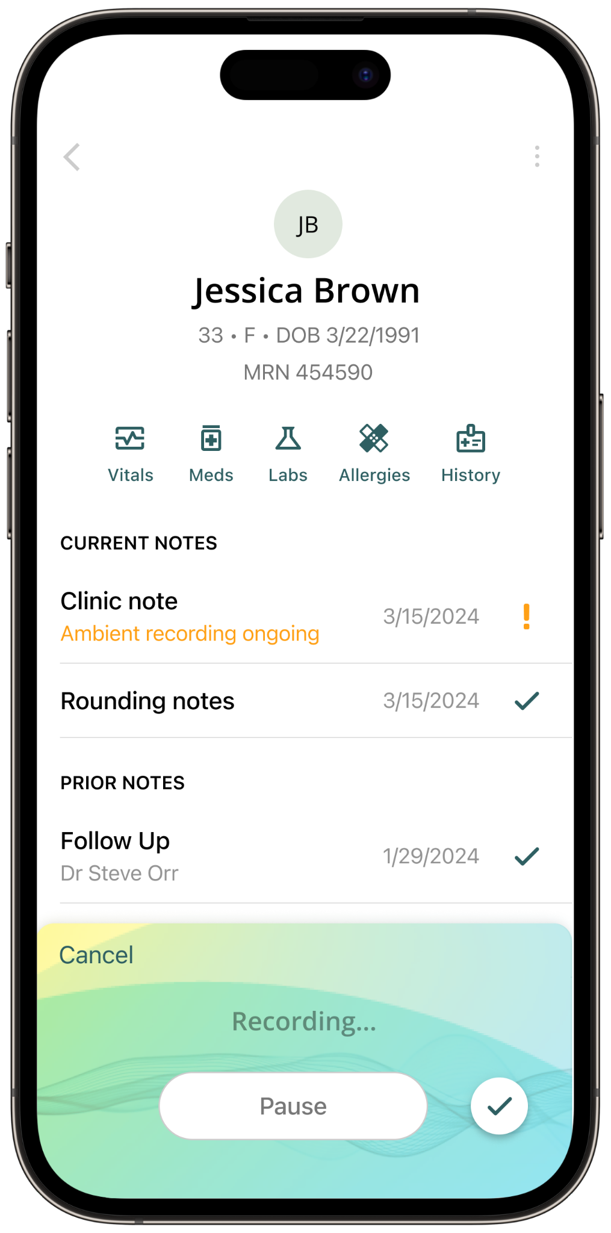
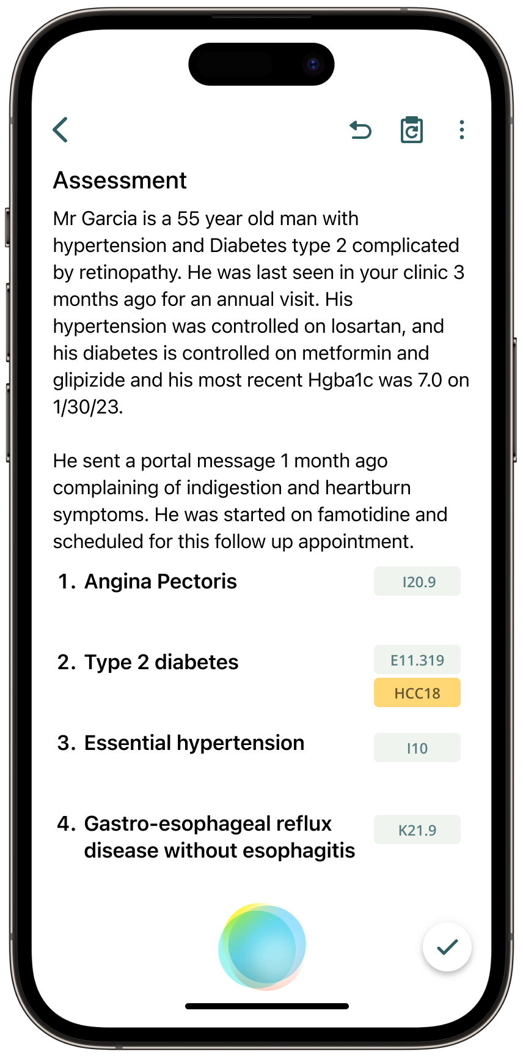
Performance considerations
Real-time transcription (<2s)
Low WER (<10%)
Low note generation time (<1m)
Low failure rates for generation (<1%)
Real time support for command and dictation together

Slide 7
Complexity
Technical
Speech issues: noise, multi-lingual, network, style, speed etc.
AI models for transcriptions and content generation
Distributed execution
Medical data
Medical Terminology
Low tolerance of error in generated content
Interrelations in patient data
Safety and Privacy
EHR diversity
Different data formats
Variable API support
Data ingestion APIs and their performance

Slide 8
Redis Streams
Simple and fast (single instance can support 100k reads/writes per second)
Support for multiple delivery semantics
Delivery counter, time last seen, time last read, time last successfully read
Ordered by time
Seekable: XRANGE, XREVRANGE
Versatile: XTRIM, MAXLEN, MINID, XCLAIM etc.

Slide 9
Benthos
Fast data streaming and connectors (1000 transformations per second)
Supports for yaml based logic
Best for note editing; can make changes to note schema without deployment
Wide variety of connectors: redis, kafka, mysql etc.

Slide 10
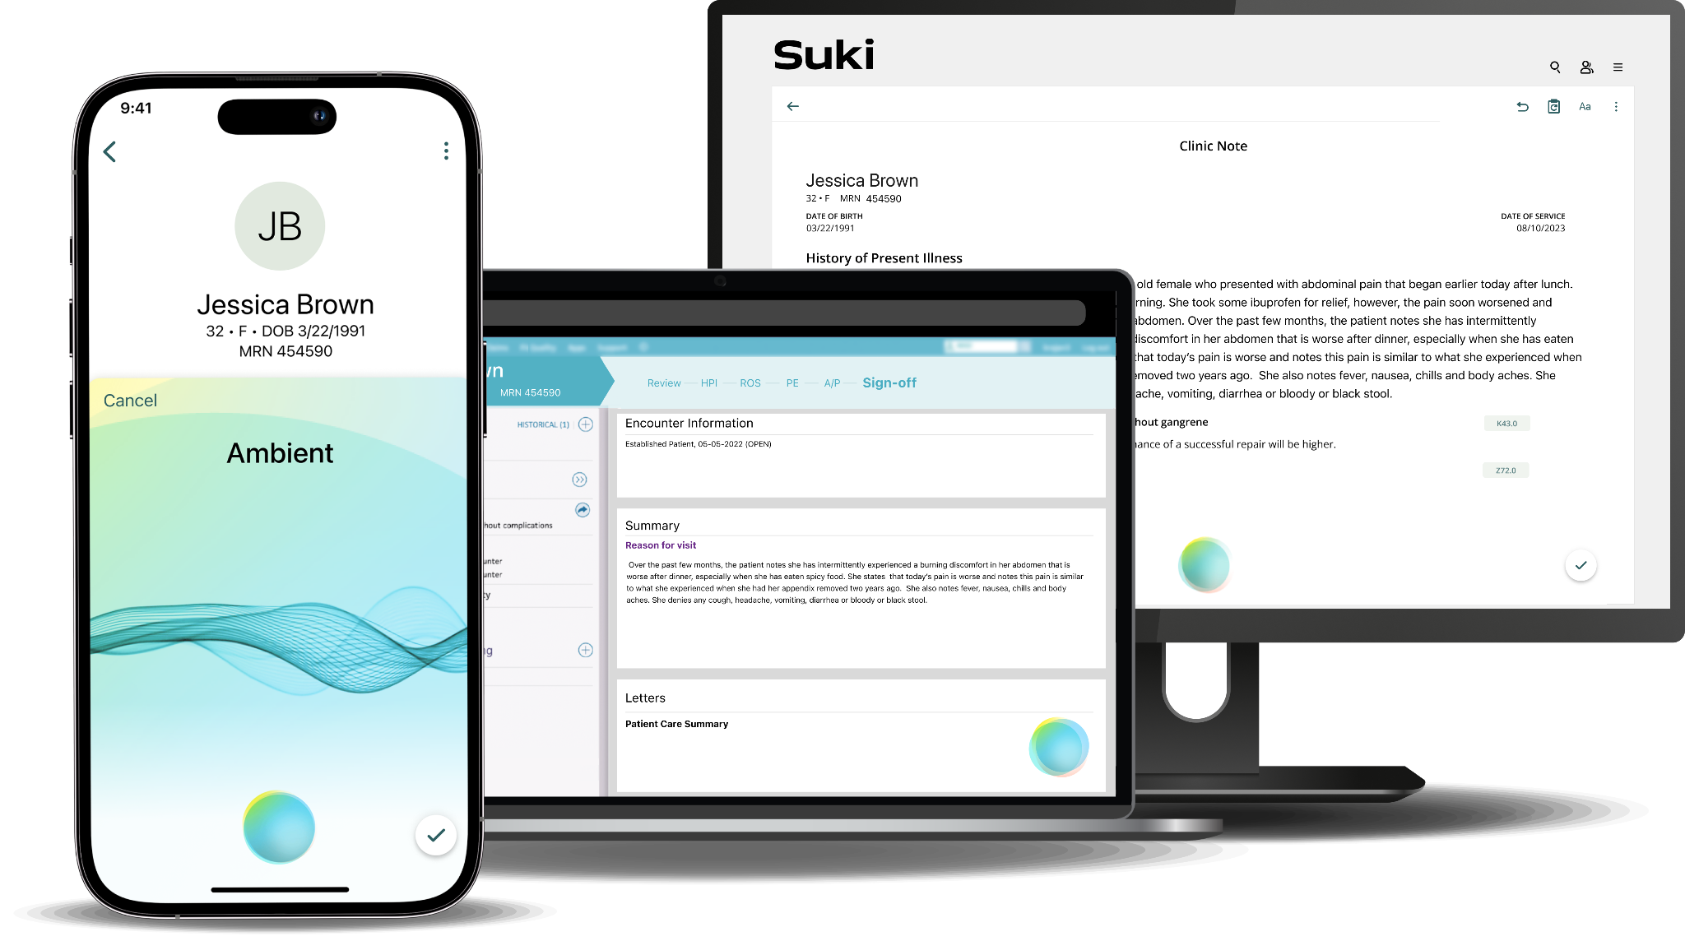
Problems with existing architecture
Not scalable
Hard to modify due to high coupling
Stateful services with in-memory management
C++
No use of foundational technologies

Slide 11
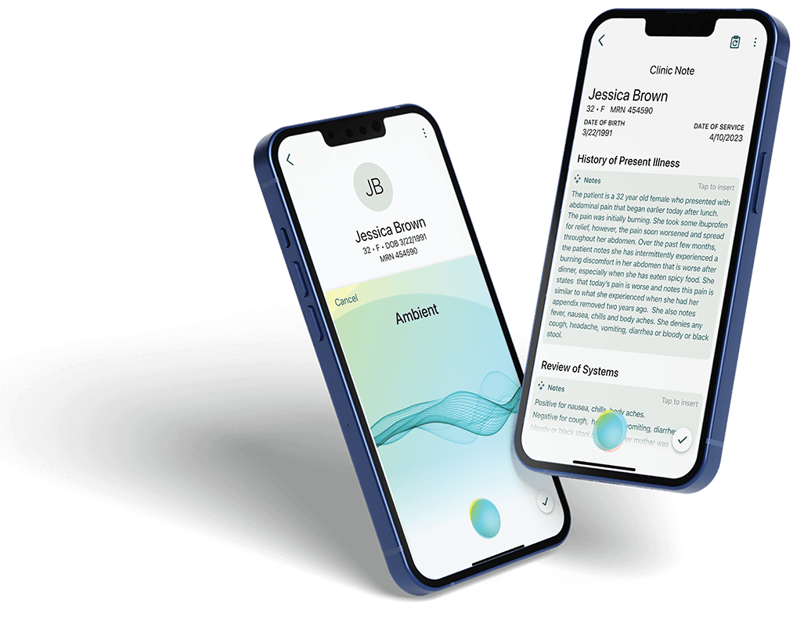
New architecture
Stateless services, Distributed state
Low coupling, explicit contracts
Independently scalable units
Go lang
Suitable technologies: Redis, Benthos

Slide 12
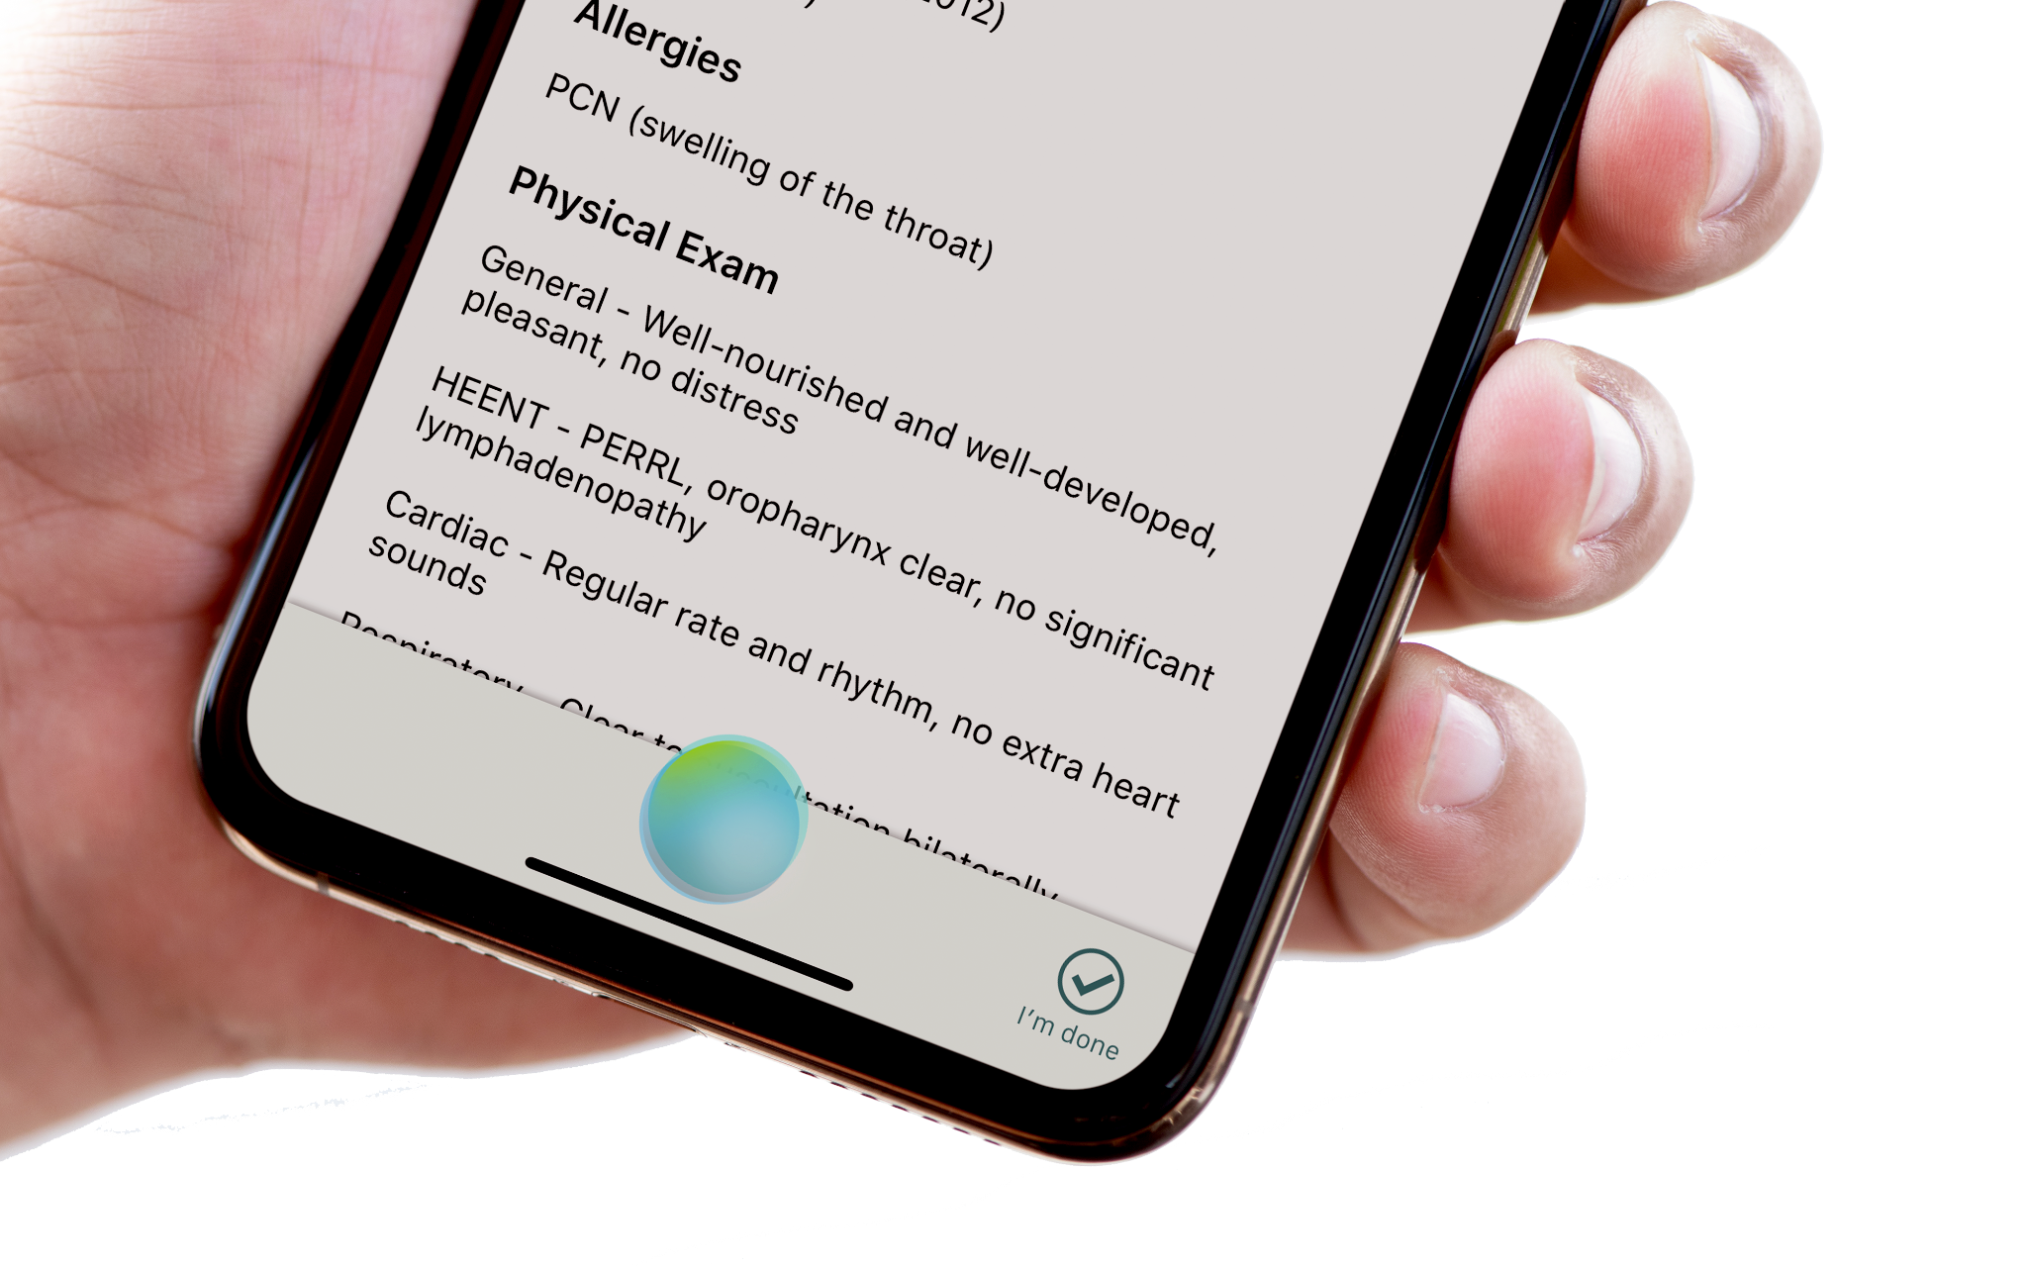
Details
10 audio packets are sent per second
Each packet is 3.2 KB in size
Transcripts are about 3 KB in size on average (largest is 1.5 MB)
Transcripts come at a rate of 1 per 3-5 seconds
Average duration of ambient: 45 mins.
Average duration of voice based dictation: 10 mins
For 100 CCUs average sessions the stack handles:
~10G audio data Peak: 520 writes / second
~1G transcript data Peak: 500 reads / second

Slide 13
Comparison
Old Stack
New Stack
12G, 4 pods serving 160 CCU
Average note generation time: 5 mins
No separate processing of streams
Any optimization required code changes, deployment → end user impact
2G, 3 pods serving 200 CCU
Average note generation time: 1 min
Separate processing of streams
All optimizations internal → no end user impact
Can support a peak of 10,000 CCU with optimizations

Slide 14
LLM Performance
Highly specific to application and domain
Per user evaluation is basis of performance
Threshold to decide when to move from commercial models to open-source or hybrid approaches

Slide 15
ASR performance
Based on Whisper - medium and Whisper - large.
GPU performance single most important parameter
Tradeoffs
Batch inference
TPU
GPU Data parallelism
Faster models with acceptable accuracy margins

